Slide 1
CS 410 – Introduction to Software Engineering
Lecture 5 – Design I
_{Fall 2019}

Slide 2
Usability

Slide 3
Usability: Design for Usability
Usability of a computer system is a combination of factors:
User interface design
Functionality (functional requirements)
Performance (non-functional requirements)
Help systems and documentation
Freedom from errors

Slide 4
Design: User Interface Design
The user interface design is the appearance on the screen and the actual manipulation by the user (look and feel)
  Fonts, colors, logos, key board controls, menus, buttons
  Mouse control or keyboard control?
  Conventions (e.g., "back", "help")

Slide 5
Usability: Same Functions, Different Interface
The user interface design is different from the functionality provided.
Example 1: Microsoft Word on Windows and Macintosh:
Different user interfaces for the same functionality.
Example 2: The desktop metaphor
Mouse -- 1 button (Macintosh), 2 button (Windows) or 3 button (Unix)
Close button -- left of window (Macintosh) , right of window (Windows)

Slide 6
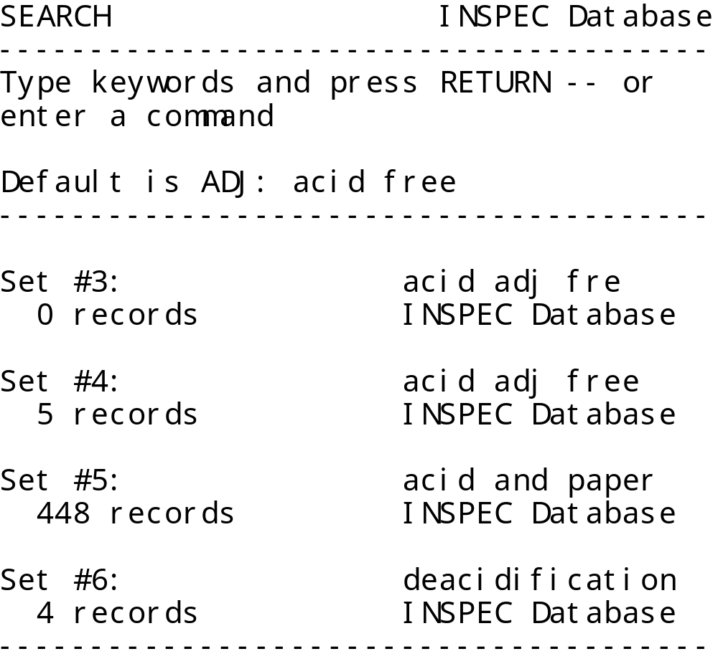
Usability: 1990

Slide 7
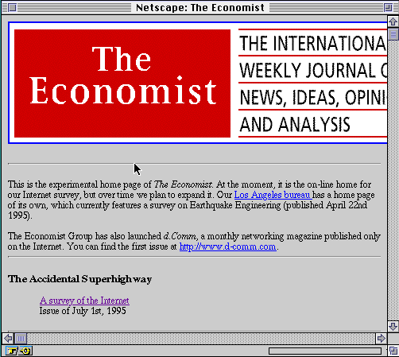
Usability: 1995

Slide 8
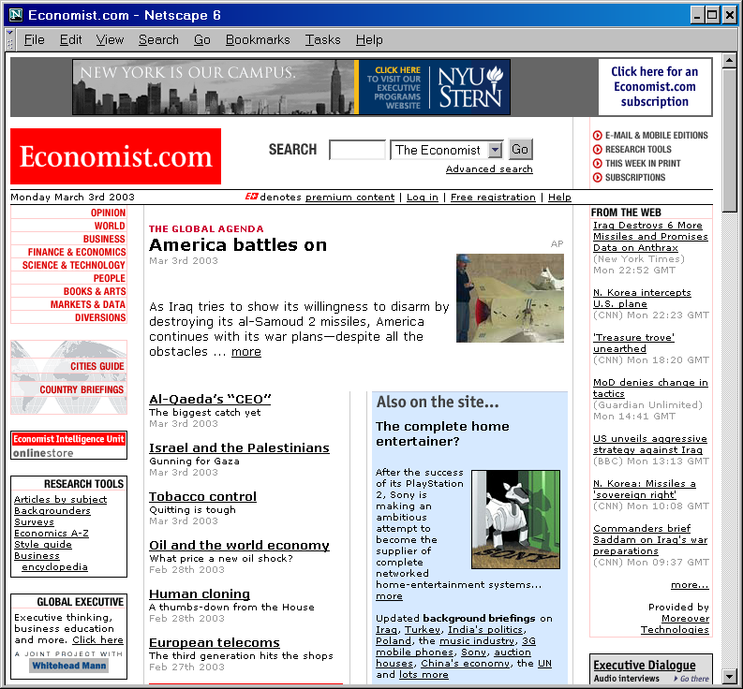
Usability: 2003

Slide 9
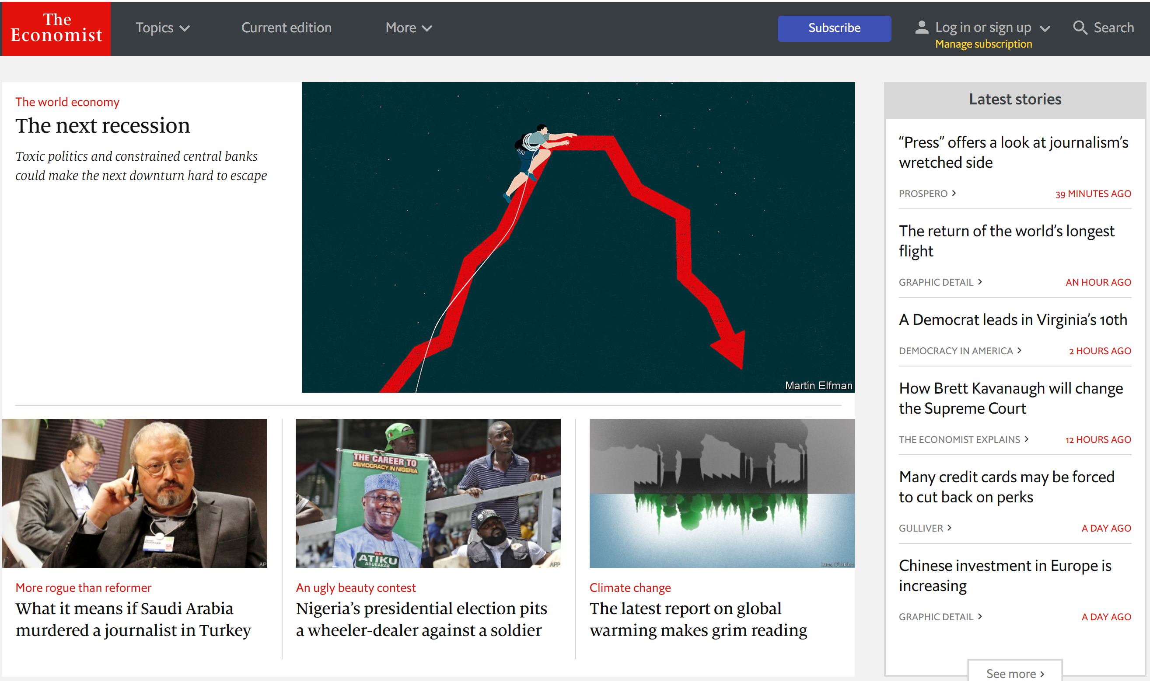
Usability: 2018

Slide 10
User Interface Design: Requirements and Refinement
It is very difficult to specify and comprehend an interactive interface in textual documents.
Requirement documents benefit from sketches, comparison with existing systems, etc.
Design documents should definitely include graphical elements and often benefit from a mock-up or other form of prototype.
Implementation plans should include evaluation of user factors and time to make changes.
USER INTERFACES MUST BE TESTED WITH USERS

Slide 11
User Interface Design: The Design/Evaluate Loop
Design
Analyze requirements
?
Build
Evaluate

Slide 12
User Interface Design: Mock-up
Logo
Insert Picture Here

Slide 13
User Interface Design: Focus Group
A focus group is a group interview
Interviewer
Potential users
  Typically 5 to 12
  Similar characteristics (e.g., same viewpoint)
Structured set of questions
  May show mock-ups
  Group discussions
Repeated with contrasting user groups

Slide 14
User Interface Design: Usability Laboratory
Monitor users while they use system (or a prototype)
Evaluators User
one-way mirror

Slide 15
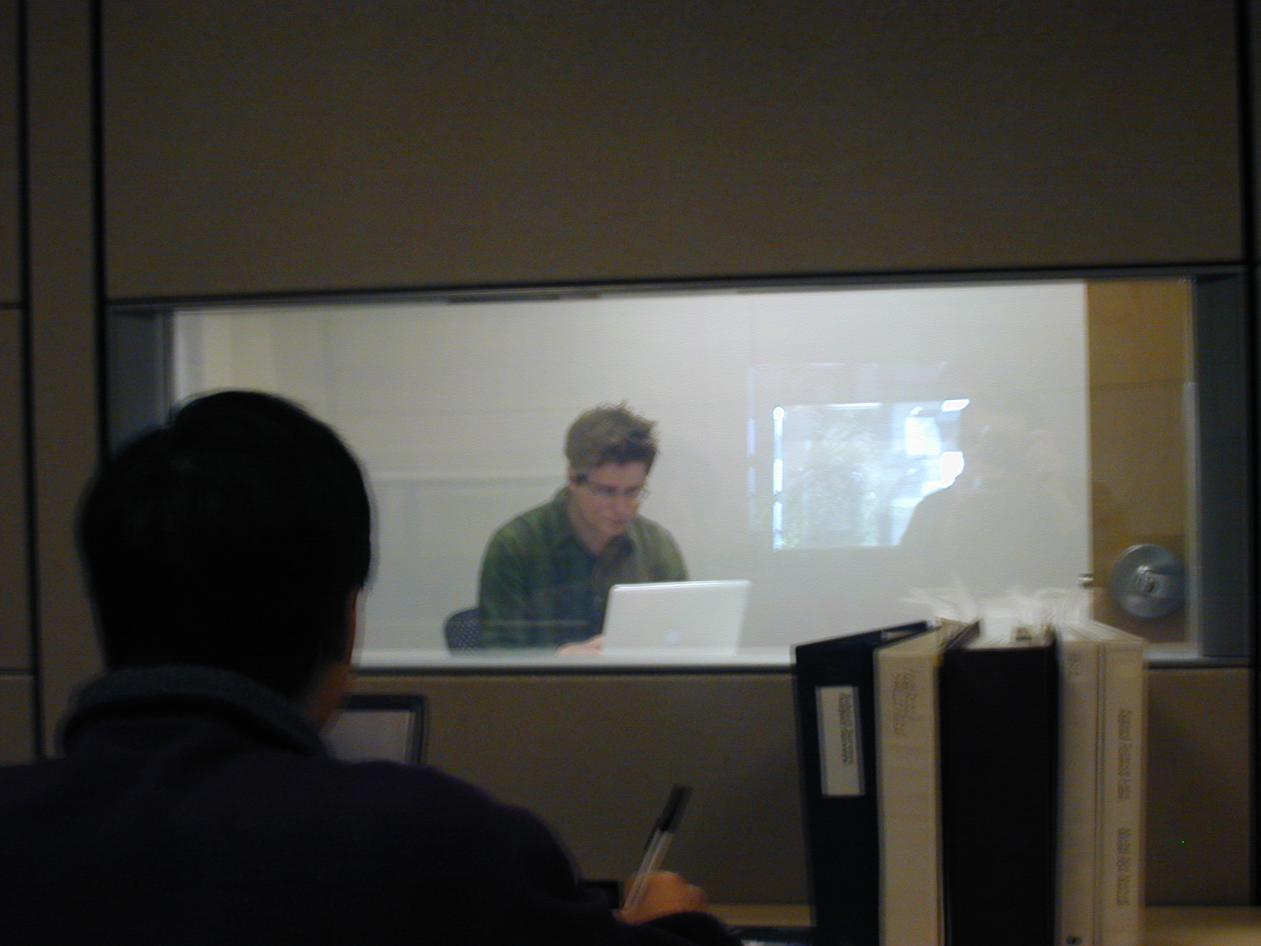
User Interface Design: Usability Laboratory

Slide 16
User Interface Design: Eye Tracking
Basic concept: log events in the users' interactions with a system
Examples from a Web system
Clicks (when, where on screen, etc.)
Navigation (from page to page)
Keystrokes (e.g., input typed on keyboard)
Use of help system
Errors
May be used for statistical analysis or for detailed tracking of individual user.

Slide 17
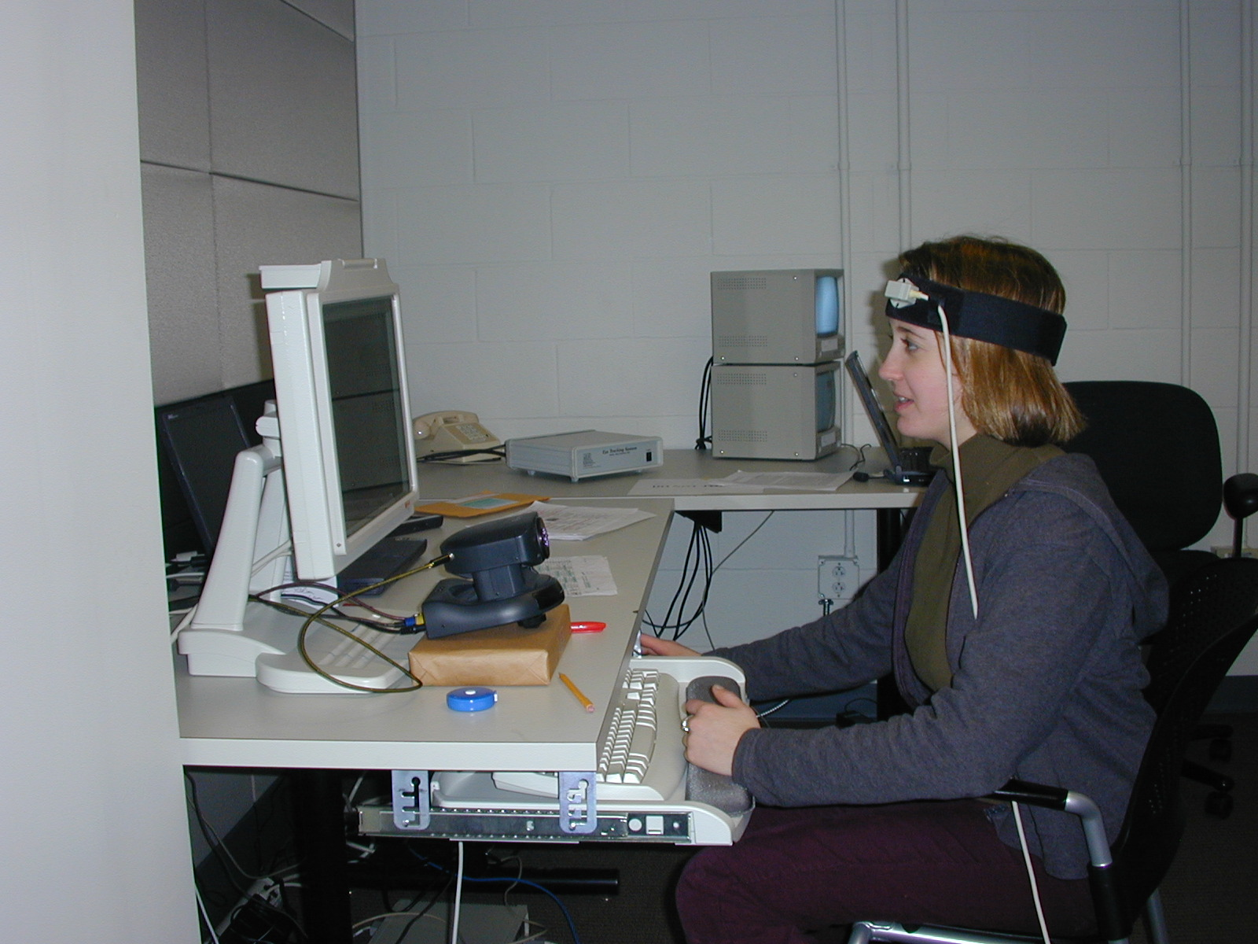
User Interface Design: Eye Tracking

Slide 18
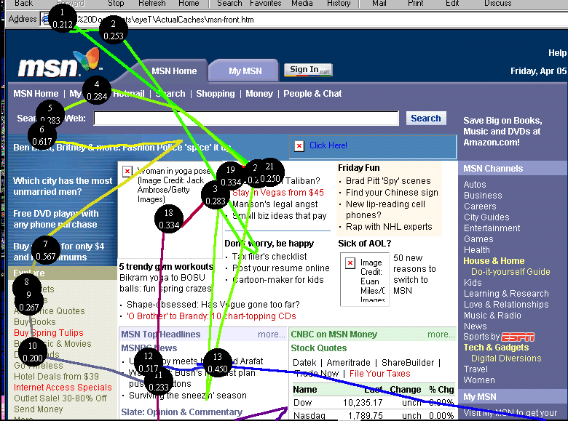
User Interface Design: Eye Tracking

Slide 19
User Interface Design: Principles
Interface design is partly an art; there are general principles:
Consistency -- in appearance, controls, and function.
Feedback -- what is the computer system is doing? Why does the user see certain results?
Users should be able to interrupt or reverse actions
Error handling should be simple and easy to comprehend
Skilled users offered shortcuts:
  beginners have simple, well-defined options
The user should feel in control

Slide 20
Styles of User Interfaces: Command Line Interfaces
User interacts with computer by typing commands
Allows complex instructions to be given to computer
Facilitates formal methods of specification & implementation
Skilled users can input commands quickly
Requires learning or training
Can be adapted for people with disabilities
Can be multi-lingual
Suitable for scripting / non-human clients

Slide 21
Styles of User Interfaces: Direct Interaction
User interacts with computer by manipulating objects on screen
Can be intuitive and easy to learn
Users get immediate feedback
Not suitable for some complex interactions
Does not require typing skills
Straightforward for casual users, slow for skilled users
Icons can be language-independent
Difficult to build scripts
Only suitable for human users

Slide 22
User Interface Design: System Considerations
Personal computer cycles are there to be used
Any network transfer involves delay
Shared systems have unpredictable performance
Data validation often requires access to shared data
Mobile code poses security risks

Slide 23
User Interface Design: Information Presentation
Simple is often better than fancy
Text
  precise
  unambiguous
  fast to compute and transmit
Graphical interface
  simple to comprehend / learn
  uses of color
  shows variations

Slide 24
User Interface Design: Special Considerations - Disabilities
What if the user:
  is visually impaired or color blind?
  does not speak English?
  is a poor typist?
There is a tradition of blind programmers
Navigation of web sites need not be only visual
You may have a legal requirement to support people with disabilities

Slide 25
User Interface Design: Special Considerations – Computer Systems and Networks
The performance, reliability and predictability of computer systems and networks is crucial to usability
Response time
  instantaneous for mouse tracking and echo of key stroke
  instantaneous for VR/AR applications
  5 seconds for simple transactions
Example: Pipelined algorithm for the Mercury page turner
Quality of Service for real time information

Slide 26
User Interface Design: Special Considerations – Device-Aware User Interfaces
Examples of devices:
  desk-top computer, fast network connection
  laptop computer, intermittent connectivity
  palmpilot, synchronization
  smart telephone
  digital camera, camcorder
Device-aware user interfaces are aware of:
  performance of device
  limited form factor (display, keyboard)
  connectivity

Slide 27
User Interface Design: Special Considerations – Usability and Cost
Good usability may be expensive in hardware or special software development
User interface development may be a major part of a software development project
Programming environments provide powerful user interface
Toolkits
Costs are multiplied if a user interface has to be used on different computers or migrate to different versions of systems
Web browsers provide a general purpose user interface where
others maintain the user interface software

Slide 28
User Interface Design: Importance
Good support for users is more than a cosmetic flourish
Elegant design, appropriate functionality, & responsive system:
  a measurable difference to their effectiveness
A system that is hard to use:
  users may fail to find important results, or misinterpret what they do find
  user may give up in disgust
A computer system is only as good as the interface it provides to its users

Slide 29
System Architecture

Slide 30
End

